Slide 1
Multilevel Modeling for Systems Engineering
12th International Workshop on Multi-Level Modeling (MULTI 2025)
Grand Rapids, Michigan
7 October 2025
Ed Seidewitz
CTO, Model Driven Solutions
ed-s@modeldriven.com

Slide 2
Systems Engineering
Systems Engineering is a transdisciplinary and integrative approach to enable the successful realization, use, and retirement of engineered systems, using systems principles and concepts, and scientific, technological, and management methods.
International Council on Systems Engineering (INCOSE)

Slide 3
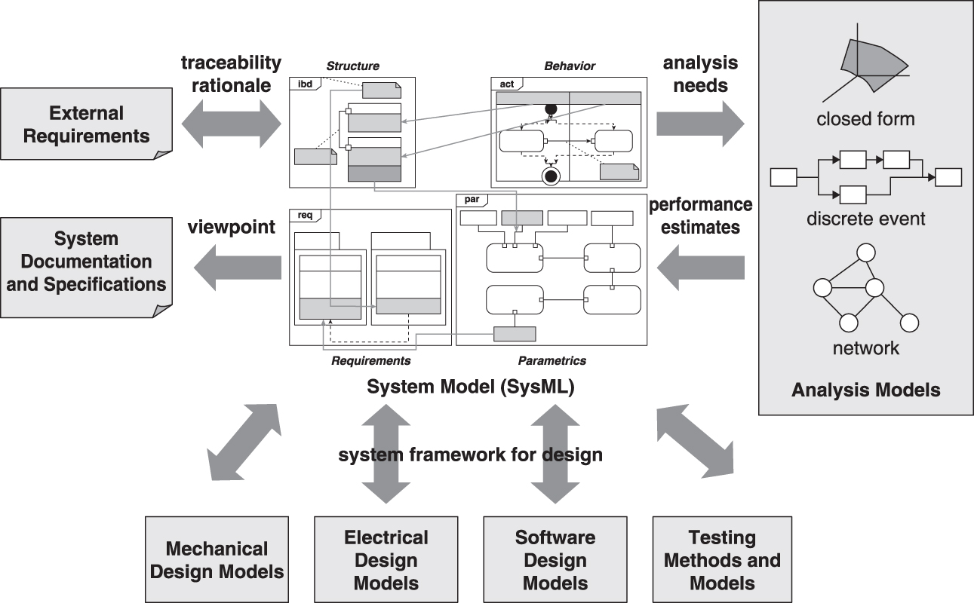
Model-Based System Engineering (MBSE)
puts the System Model at the center
A Practical Guide to SysML 3rd Edition (Figure 18.1)

Slide 4
Systems Modeling Language™ (SysML®)
“Systems Modeling Language” and “SysML” are trademarks of the Object Management Group
Supports the specification, analysis, design, and verification and validation of complex systems that may include hardware, software, information, processes, personnel, and facilities
SysML v1.0 adopted in 2006 Standard profile of UML v2.1
SysML v1.7 adopted in 2022 Last version for SysML v1
SysML v2 RFPs issue Language: December 2017 API and Services: June 2018
SysML v2.0 adopted in 2025 First version for SysML v2

Slide 5
SysML v2 Language Capabilities

Slide 6
SysML v2 Language Architecture
Systems Modeling Language (SysML)
Systems Syntax
metamodel
Systems and Domain Model Libraries
semantic library
Kernel Modeling Language (KerML)
Kernel Syntax
metamodel
Kernel Model Library
semantic library
semantic
specification
Core Syntax
Core Semantics
Root Syntax

Slide 7
Multilevel Modeling with Potency
Neumayr and Schuetz, “Multilevel Modeling”, Encyclopedia of Database Systems, Springer, 2017
Product
taxRate¹ : Rational
price² : Rational
owner³ : String
M3
«instanceOf»
Car : Product
taxRate⁰ = 0.10
price¹ : Rational
owner² : String
Engine
horsePower¹ : Integer
engineNum² : Integer
M2
engine²
«instanceOf»
«instanceOf»
FordMustangGT : Car
price⁰ = 46560.00
owner¹ : String
Ti_VCT_V8 : Engine
horsePower⁰ = 480
engineNum¹: Integer
M1
engine¹
«instanceOf»
«instanceOf»
MarysCar : FordMustangGT
owner⁰ = “Mary”
: Ti_VCT_V8
engineNum⁰ = 1234
M0
engine⁰

Slide 8
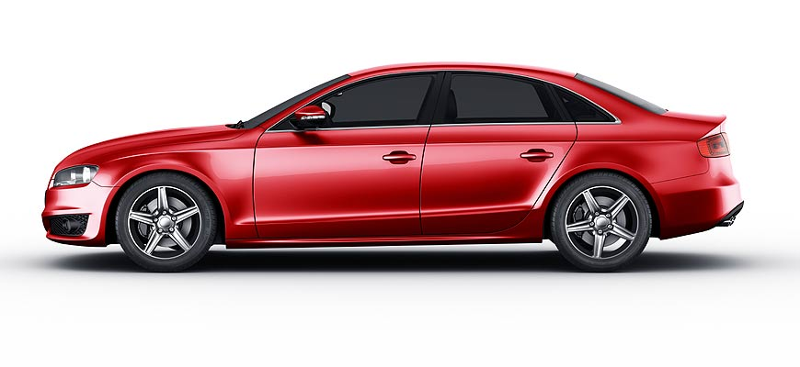
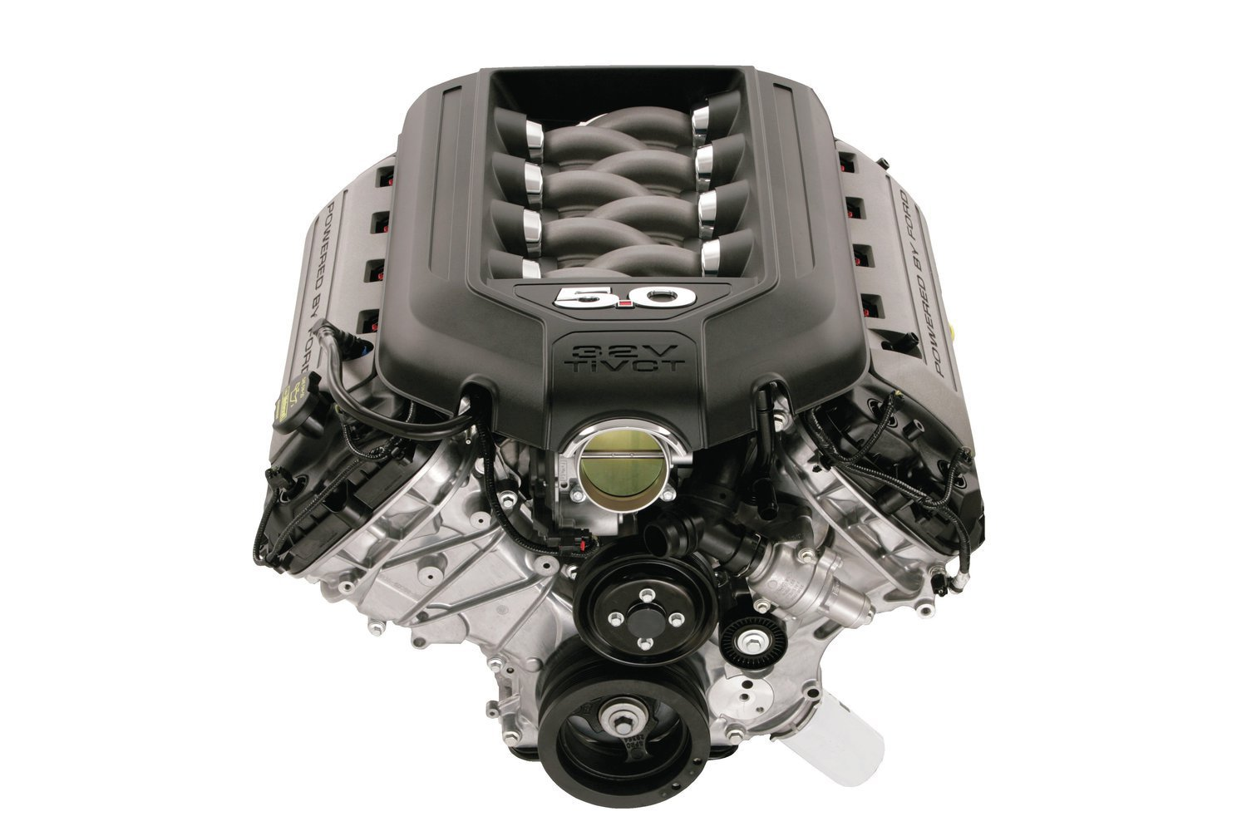
Multilayer Modeling with SysML v2
A usage (of a definition) classifies the pairing of a featuring instance to a feature value.
An individual definition classifies a single instance.
«individual part def» MarysCar
attributes
owner = “Mary”
«individual part def»
MarysCarEngine attributes
engineNum = 1234
M1
«part» engine
:
classifies
classifies
classifies
M0

Slide 9
Multi-Layer Modeling with SysML v2
Redefinition is a kind of specialization between usages.
«part def» FordMustangGT
attributes
price = 46560.00
owner : String [0..1]
«part def» Ti_VCT_V8
attributes
horsePower = 480
engineNum: Integer
«part» engine
:
Subclassification is a kind of specialization between definitions.
:>> is a shorthand for “redefines”, = represents binding
«individual part def» MarysCar
attributes
:>> owner = “Mary”
«individual part def»
MarysCarEngine attributes
:>> engineNum = 1234
M1
«part» engine
:
classifies
classifies
classifies
M0

Slide 10
Multi-Layer Modeling with SysML v2
Urbán, Theisz, and Mezei, “Self-describing operations for multi-level meta-modeling”, MODELSWARD 2018
«part def» Car
attributes
price : Rational
owner : String [0..1]
«part def» Engine
attributes
horsePower : Integer
engineNum : Integer
«part» engine
:
«part def» FordMustangGT
attributes
:>> price = 46560.00
^owner : String [0..1]
«part def» Ti_VCT_V8
attributes
:>> horsePower = 480
^engineNum: Integer
«part» engine
:
«individual part def» MarysCar
attributes
:>> owner = “Mary”
«individual part def»
MarysCarEngine attributes
:>> engineNum = 1234
M1
«part» engine
:
classifies
classifies
classifies
M0

Slide 11
Ontological Library Model in SysML v2
:
«item def» Item
«item» subitems [*]
Subsetting is a kind of specialization between usages.
Standard Library Model
:
«part def» Part
«part» subparts [*]
«part def» Car
attributes
price : Rational
owner : String [0..1]
«part def» Engine
attributes
horsePower : Integer
engineNum : Integer
M1
«part» engine
:
User Model
classifies
classifies
classifies
M0

Slide 12
Syntax and Semantics in SysML v2
Atkinson and Künhe, “Model-driven development: a metamodeling foundation”, IEEE Software, October 2003
Ontological
Linguistic
syntax of
«item def» Item
«metadata def» ItemDefinition
semantics for
syntax of
«part def» Part
«metadata def» PartDefinition
semantics for
Standard Library Model
M1
Abstract Syntax Model
M2
syntax of
«perform action» performedActions [*]
«metadata def» PerformActionUsage
semantics for
syntax of
«action» actions : Action [*]
«metadata def» ActionUsage
semantics for

Slide 13
Syntactic Reflection in SysML v2
Ontological
Linguistic
syntax of
«item def» Item
«metadata def» ItemDefinition
:
semantics for
MetadataDefinition provides its own syntax, MetadataItem provides its semantics.
syntax of
«metadata def» MetadataItem
«metadata def» MetadataDefinition
semantics for
:
syntax of
«item» metadataItems [*]
«metadata def» MetadataUsage
semantics for
syntax of
«item» items [*]
«metadata def» ItemUsage
«metadata def» AnnotatingElement
semantics for

Slide 14
Semantic Metadata in SysML v2
Ontological
Linguistic
«part def» Car
attributes
price : Rational
owner : String [0..1]
«metadata def» <car> CarMetadata
references
:>> baseType = Car meta SysML::Type
semantics for
Semantic metadata implies that its annotated element specializes the given baseType.
The meta operator “meta-casts” an element to its abstract syntax metaobject.
«part» engine
«metadata def» SemanticMetadata :> Metadata
references
baseType : SysML::Type
«part» engines [*]
:
semantics for
«metadata def» <engine> EngineMetadata
references
:>> baseType = engines meta SysML::Type
«part def» Engine
attributes
horsePower : Integer
engineNum : Integer

Slide 15
Language Extension in SysML v2
The #car annotation implies subclassification of Car.
The #engine annotation implies subsetting of engines (which is redefined to be a single engine for a Car).
«#car def» FordMustangGT
attributes
:>> price = 46560.00
^owner : String
«#engine» gtEngine
attributes
:>> horsePower = 480
^engineNum: Integer
Typing is also a kind of specialization, so usages inherit from their definitions.
«individual #car def» MarysCar
attributes
:>> owner = “Mary”
«#engine»
MarysCarEngine attributes
:>> engineNum = 1234

Slide 16
System Model vs. Information Model
System
Information
«part def» Car
parts
engine : Engine
«item» carCategory [1]
:>> taxRate = 0.10
«item def» ProductCategory
taxRate : Rational
cars
:
*
models
*
«part def» FordMustangGT
parts
:>> engine : Ti_VCT_V8
«item» fordMustangGTModel :> models [1]
:>> price = 46560.00
«item def» ProductModel
price : Rational
:> cars
:
*
products
*
«individual part def» Car5678
parts
:>> engine = Engine1234
«item» marysCarInfo :> products [1]
:>> owner = “Mary”
«item def» ProductInfo
owner : String [0..1]
:> cars
:
1

Slide 17
Conclusion
Systems models reflect the semantics of (ontological) classification more than (object-oriented) instantiation or materialization.
Many of the goals of multilevel metamodeling can be achieved using multilayer specialization and refinement.
But, without the concept of deep instantiation, it is hard to specify the equivalent of potency.
Linguistic syntactic modeling at a higher metalevel can be naturally related to ontological semantic modeling at the next lower metalevel.
Reflection makes it possible to move between metalevels and enables semantic language extension.
One needs to distinguish models of systems from models of information about systems.
But models are information about systems!

